Slide 1
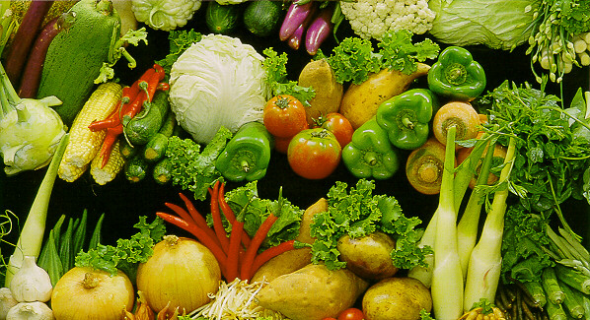
Farmer's Friend

Slide 2
Project Overview
Identifying problems
Planning solutions
Executing Plans
  Phase I : Identifying sensors (Minor)
  Phase II :Making Data Acquisition System(Minor)
  Phase III:Recording Data on SD CARD(Major)
  Phase IV:Sending data to mobile via SMS (Major)

Slide 3
Identifying Problem
Farmers in India have to face lot of problem due to uncertainty in the weather condition or on non-punctual arrival of monsoon in country.
Thus Govt. and Metrological department of country provide them with weather forecast of the area where they grow crops.
But Govt. cant assist such a large number of farmer on the individual basis and recommend them the solution as they don't know the data of particular farm owned by the farmer.
All the data is generalized for particular area and cannot point out the mistake done by particular farmer.

Slide 4
Planning solution
We know how doctors diagnose the patient by conducting some test and then generating the report for the same.
This report is then compared to that of healthy person and finally patient gets solution.
This project is all about diagnosing those problems related to farm rather then human body.
Here we collect all the data from sensors fitted in the farm into storage device and transmit it for analysis to internet.
Thus this project can help farmers to get consultation from agricultural scientist remotely.
In laymen terms:
Farmer growing crop in Maharashtra getting consultation from scientist seating in Delhi Airport.

Slide 5
Phase I: Sensors
Ph value: Ph electrode with BNC Connector.
Light intensity: BH1750
Rain:YL83 with LM393
Soil moisture: RLL/ASMS/14/001
Pressure: BMP180
Temperature:DHT11
Humidity:DHT11

Slide 6
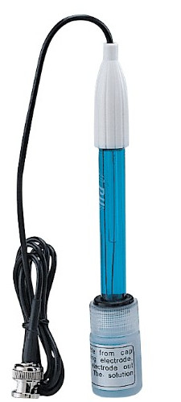
1.pH Sensor
Output Type:BNC analog
Range: 0 to 14 pH
Unit: pH

Slide 7
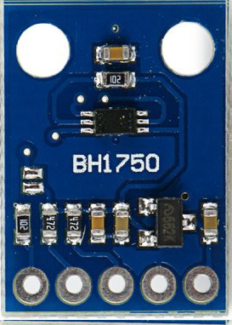
2. Light Sensor
Input: 3.4V to 5V
Output type : I2C
Range:0.001-999
Unit: Lx

Slide 8
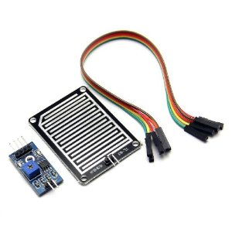
3. Raindrop Detector
Input: 5V
Output type : Analog
Range:0-4V
Unit: Volts

Slide 9
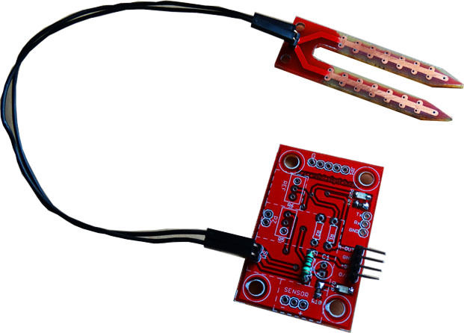
4. Soil Moisture
Input: 5V
Output type : analog
Range:0.1v to 5v
Unit: Volts

Slide 10
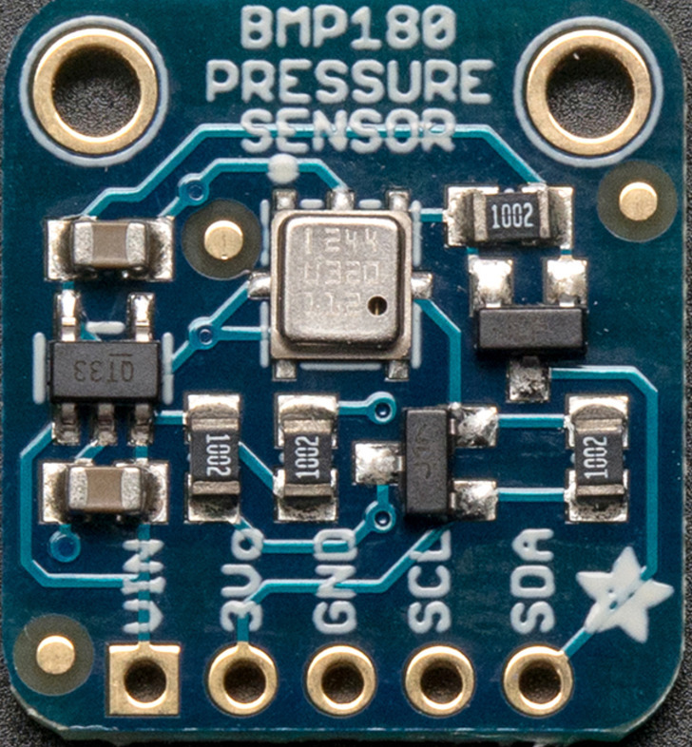
5. Pressure Sensor
Input:5V
Output type : I2C
Range:300-1100hPa
Unit:hPa

Slide 11
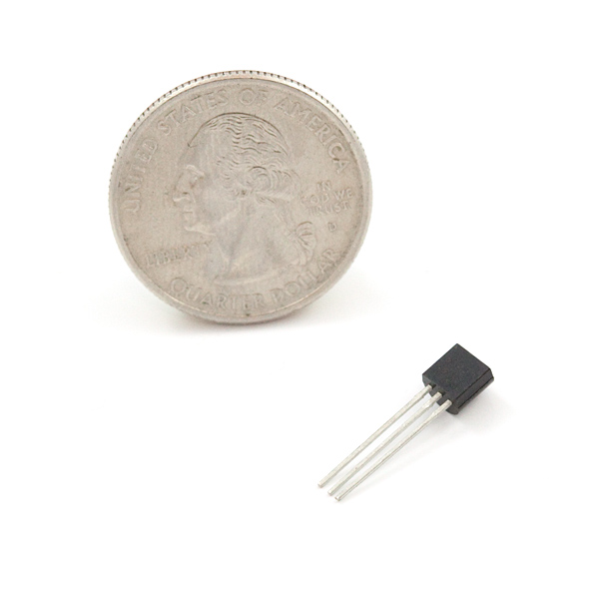
6. Temperature Sensor
Input: 5V
Output type : Dallas: 1 wire proprietary
Range:-55 to +125
Unit: Celsius

Slide 12
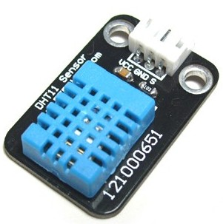
7. Humidity sensor
Input: 5V
Output type :1 wire proprietary
Range:0 to 100%
Unit: RH(Relative Humidity)

Slide 13
End of Phase I

Slide 14
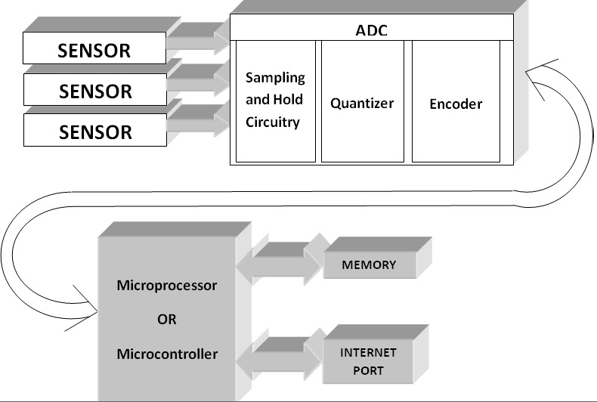
Phase II
In order to make Data acquisition system we need to use some kind of microcontroller which can get data from all the sensors and transform them from analog to digital(only if required).
This digital data can now be stored and transmitted as required.

Slide 15
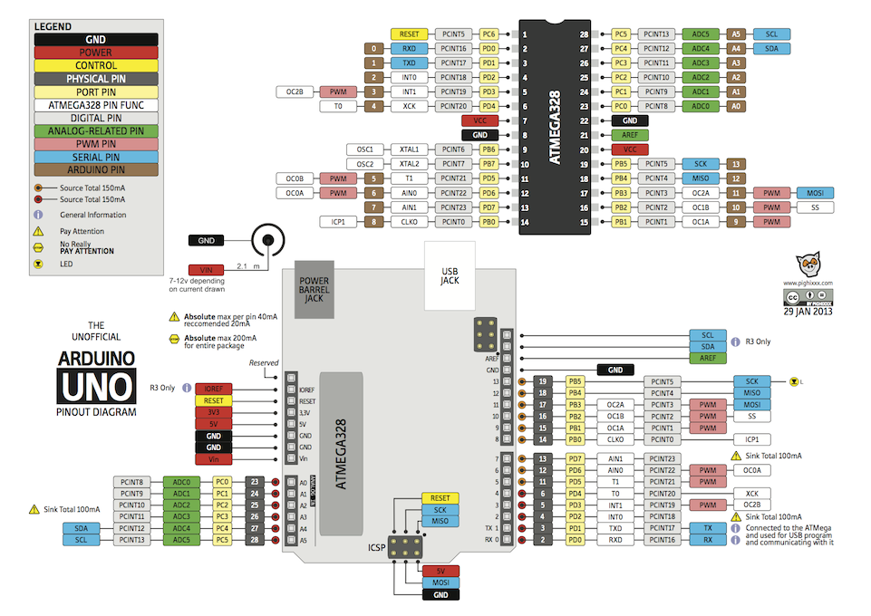
Choosing Micro-controller
Since we are using 7 sensors with some of them having 1 wire proprietary communication protocol.
Hence arduino suits our precise requirement of supporting 1 wire proprietary system with lots of pin to connect with sensors,sd card,display unit and transmission unit.

Slide 16
End of Phase II

Slide 17
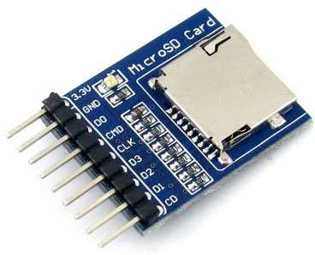
Phase III: Recording Data
The data from all this sensors needs to be put on some place before they are ready for data analysis or transmission thus we will send the data via arduino to SD card using SPI(Serial Peripheral Interface).
After storing the data with some time stamp using RTC module we can send it to internet when connection is available.

Slide 18
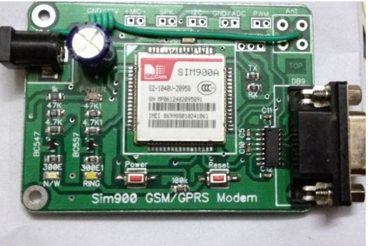
Phase IV: Sending Data Via SMS
This is Sim900A module which will be used to transmit data via sim card.

Slide 19
End of presentation.

